Slide 1
Liver Transplant Data Analysis
Team HACK
Yujia Deng, Ang Mai, Hyun Jun Choi
5/3/2018

Slide 2
Contents
Project Overview
Definition, plan, SIPOC, milestones, schedule, technical feasibility, goal
1
Data Analysis
Preprocessing, exploration, classification, regression, survival analysis
2
Product Demo
Website including data exploration and prediction tools
3
Project Closeout
Control & improvement, learning experience, future works, open questions
4

Slide 4
Project Overview

Slide 5
GOAL
Predict graft survival using pre-transplant variables

Slide 6
Project Definition & Plan
Liver Transplant Data Analysis is a semester-long project that starts in February and concludes in May 2018.
Having new idea and switching plan in the middle, postponing and missing deadline, having trouble coding, bad model performance
Risks
Obtain and study data, define goal, clean data, analyze data, test and compare models, finish assignments, finish report and end product
Scope
Project Planning
Tasks
Resources
Dataset, TA, Literature, Professor, Internet, Experience
In of Scope data analysis, create deliverables
Out of Scope data collection, data publication

Slide 7
SIPOC
Suppliers
Inputs
Process
Outputs
Customers
Keck Medicine of USC-Department of Surgery
Liver Transplant Data
Statistical Knowledge
Programming skills and language
Computers
Clean dataset
A project report
A powerpoint presentation
A website including data exploration and prediction tool
Doctors and other experts who would want to get more insights about OLT
Potential future donors and recipients
Future students in the field
Obtain and study the data
Clean and analyze the data
Complete report and product of analysis
Present results to stakeholders

Slide 8

Project Milestones and Schedule
Using Lean 6 Sigma to Achieve Team Assignments and Deliverables
Mid Apr - Early May
Improve
by using different methods and developing other potential solutions
Feb - Early Mar
Measure
performance by using process mapping and start developing statistical analysis
Late Mar - Mid April
Control
project performance by finalizing reports and ppt presentation to stakeholders and finishing end product
Define
project goals,
customer deliverables and other project details by using project charter and SIPOC diagram.
Analyze
causes of bad performing model and compare models
Mid Apr - Late Apr
Mar - Early Apr

Slide 9




Technical Feasibility Study
Risks and Solutions
Risk
Bad model performance or unrealistically high performance
Solution
Understand the code and the model, change certain parameters, use more data sources
Risk
Not familiar with syntax in coding, encounter errors
Solution
Reach out to resources to debug, use alternative methods
Model Performance
Coding
Risk
Difficulty integrating coding in Python and R
Solution
Use alternative method to display analysis result
Risk
Have new idea for analysis in the middle of the project
Solution
Adjust Gantt chart to incorporate new tasks but also ensure final deadline is not missed
Integra-
tion
New
Idea

Slide 10
2. Data Analysis

Slide 11

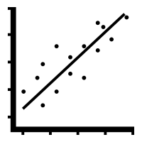

Data Analysis
Different Approaches and Data Sources
Classification
0 or 1
Neural Network
Support Vector Machine
Graft Survival Prediction
Predict survival in 1 month, 2 months, 3 months, 6 months,
9 months, and 1 year
Regression
Predict survival time (GTIME)
Linear Regression
Survival Analysis
Cox Regression
Predict time and probability until graft failure

Slide 12



Data Preprocessing
Deal with missing values
Remove invalid & non-
useful data
Create subsets
Check missing cells
Assume Missing At Random (MAR)
Categorical variables:
Impute by mode or assign to unknown category
Continuous variables:
Impute by Predictive Mean Matching
Remove observations whose GTIME>PTIME
PSTATUS=1 and GSTATUS=0
Also check PX_STAT
Remove post-transplant variables
Subset the data conditioning on GTIME and GSTATUS to create 6 new sets
New indicator variables of graft survival less than 1 month, 2 months, 3 months, 6 months, 9 months, and 1 year

Slide 13
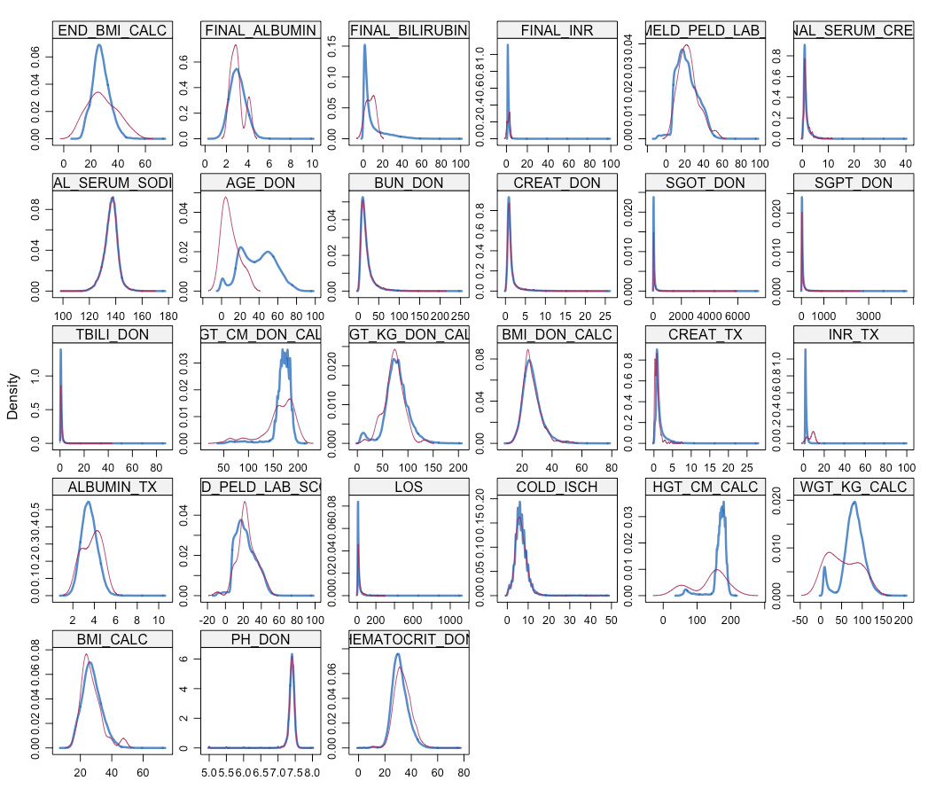
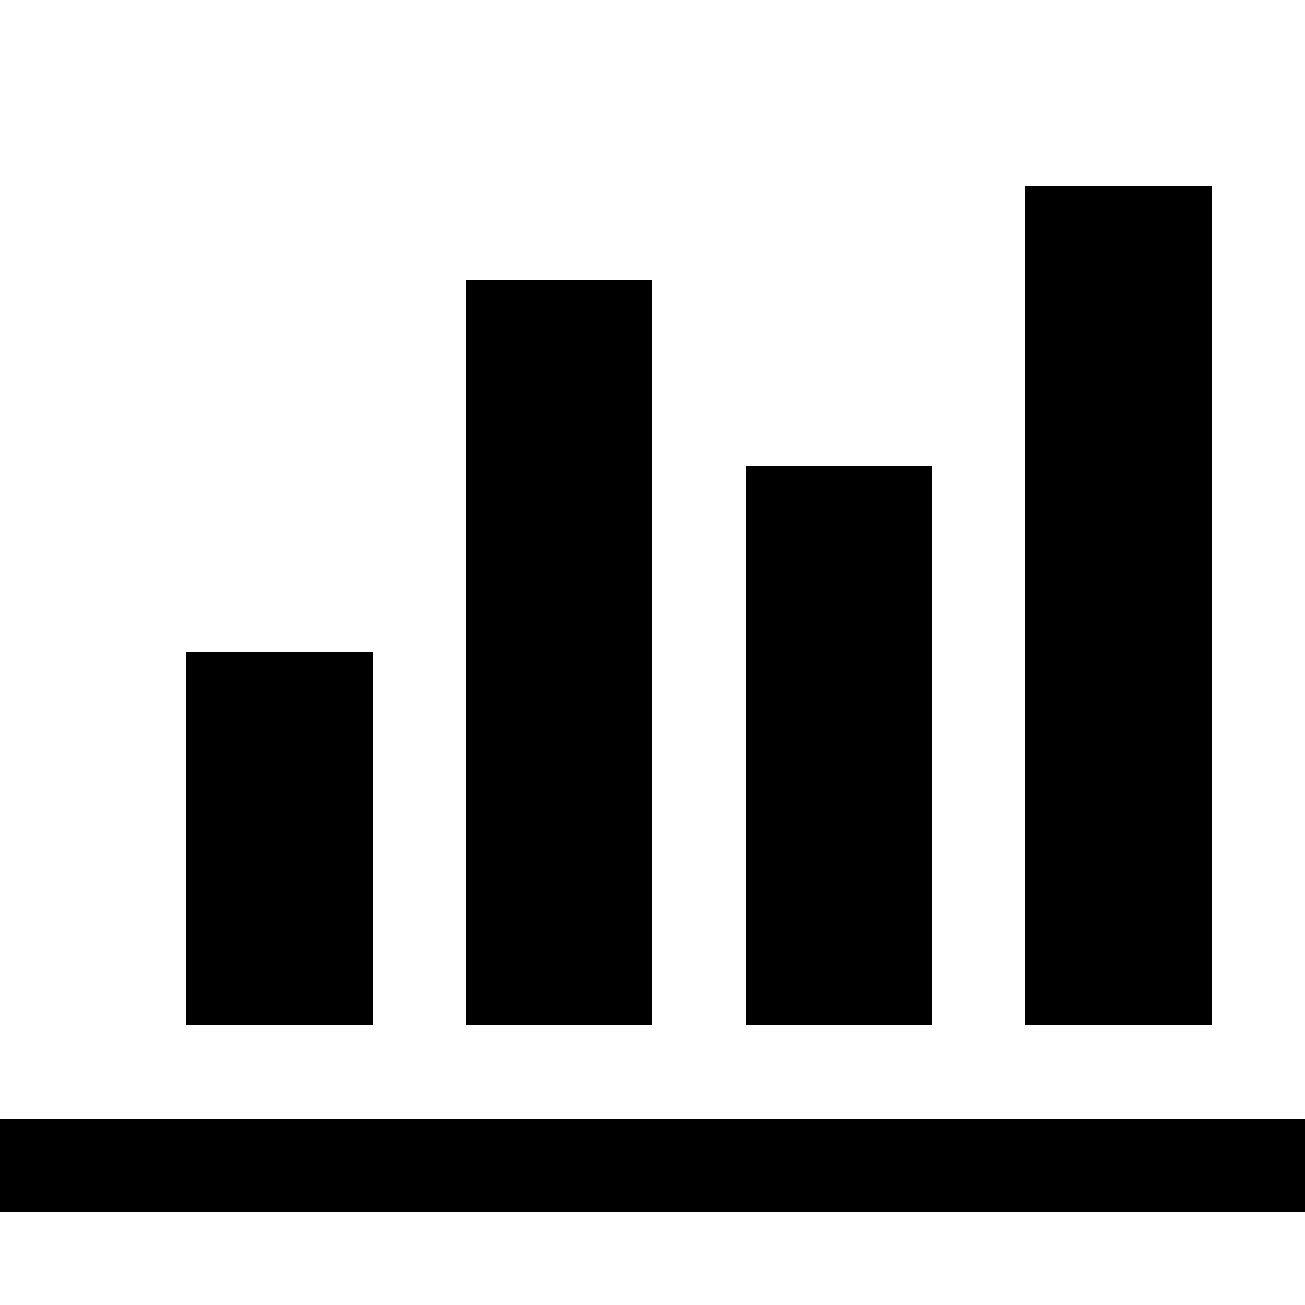

Data Preprocessing
Missing Value Imputation
Categorical Variables
1. Already had unknown category defined:
assign to unknown category
2. Had no unknown category defined
>0.05 missing: create an unknown category
<0.05 missing: assign to mode
Continuous Variables
Predictive Mean Matching
Imputed
Obsered

Slide 14
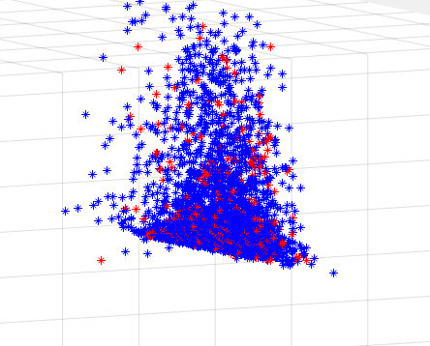
Dataset
!
Data is not linearly separable.
Imbalanced dataset problem
The number of blue points >> that of red points
What can I try to solve them?
!
?

Slide 15

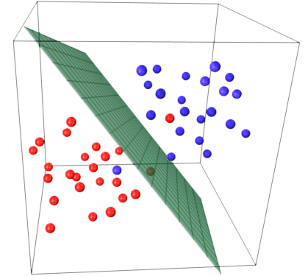
SVMs and Kernel Function
!
Data is not linearly separable.
Feature selection method
Kernel Function
Imbalanced dataset
Oversampling method
Kernel Function
!
SVM

Slide 16
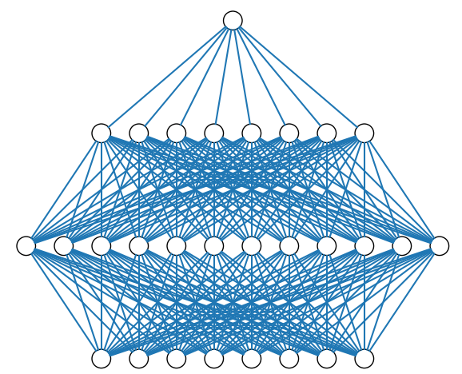
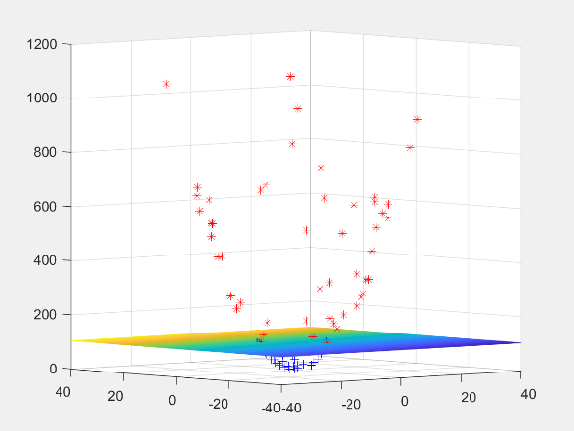
Classification Models
Neural Network
SVMs
Models neurons of brain.
Find hyperplane which classifies labels.

Slide 17
SVMs and Kernel Function
Which kernel function can transform input data into most separable feature space.
Train and Test
Feature Selection
Select Kernel Function
Calculate feature importance.
Check the accuracy by deleting unimportant feature.
Method
Boosted decision tree
Model training and testing
Kernel Functions
Polynomial Kernel
Gaussian Kernel
Exponential Kernel(Radial Basis Function kernel)
Laplacian Kernel
ANOVA Kernel
Hyperbolic Tangent (Sigmoid) Kernel
Rational Quadratic Kernel
...

Slide 18
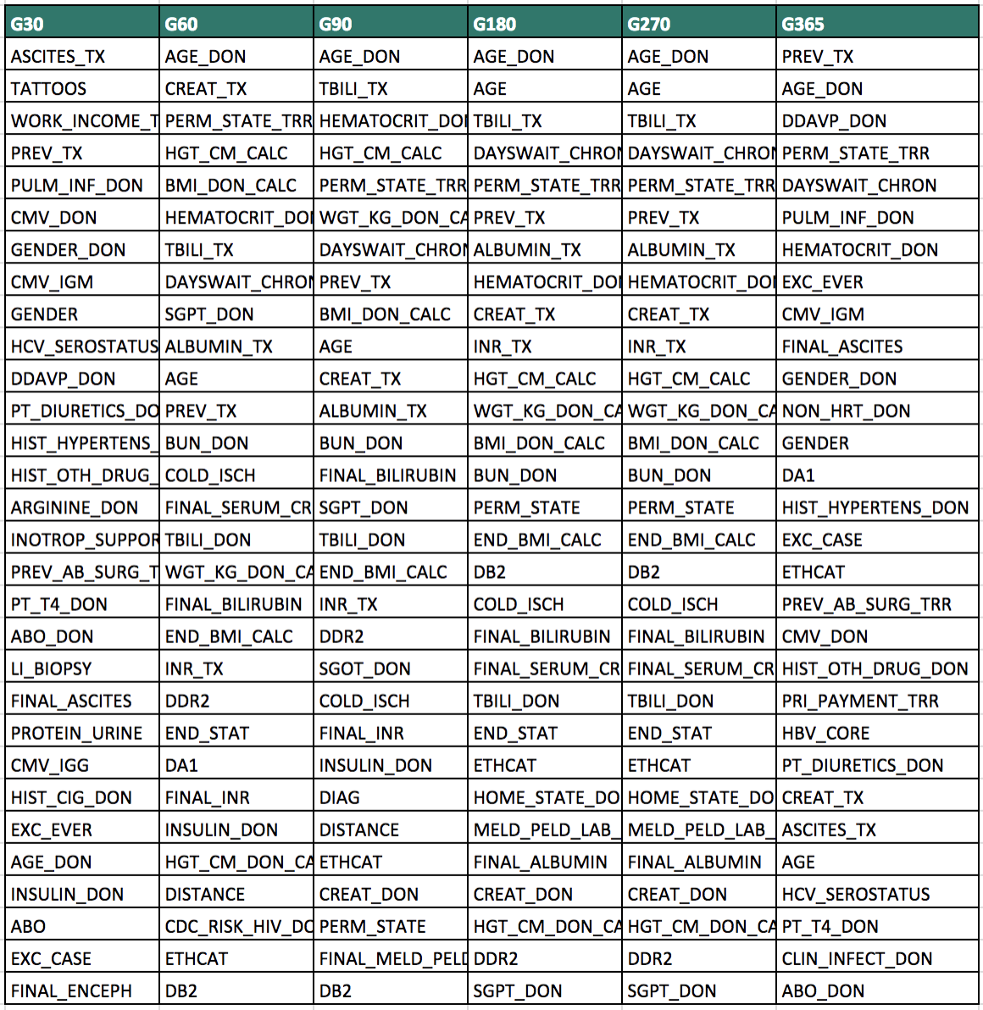
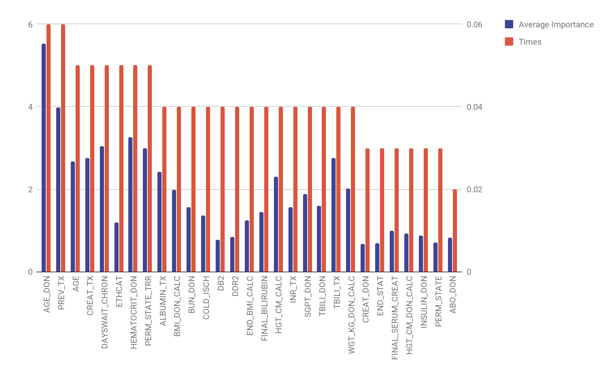
Feature Selection
Top 30 Variables from Boosted Decision Tree in each case.
Average Importance and Times Selected as Top 30

Slide 19
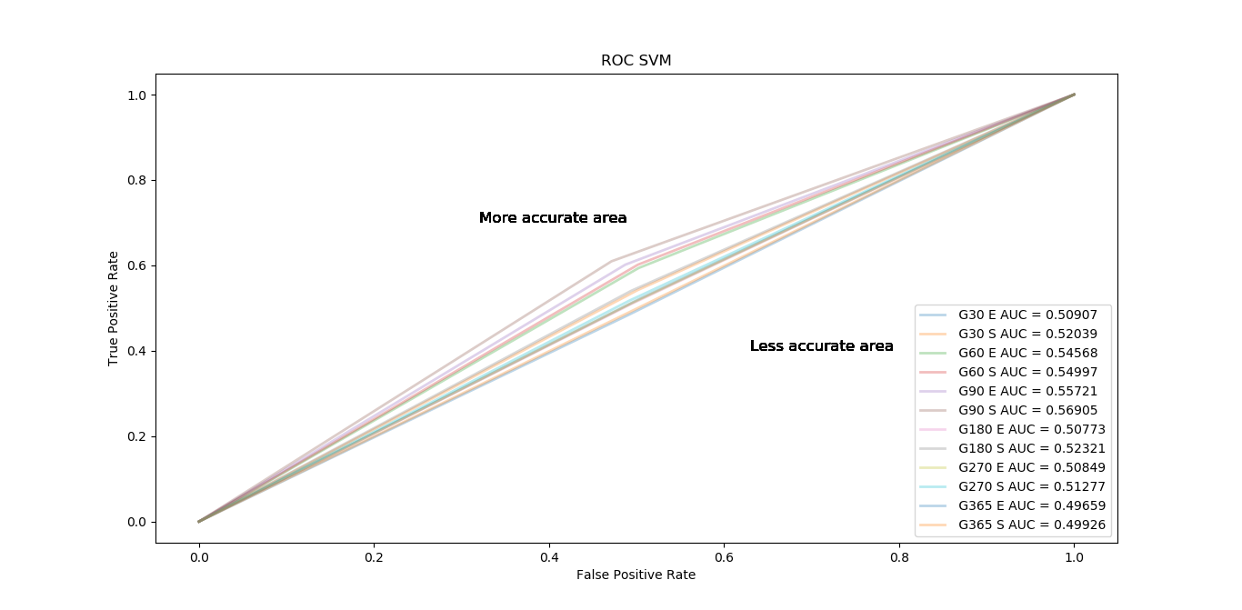
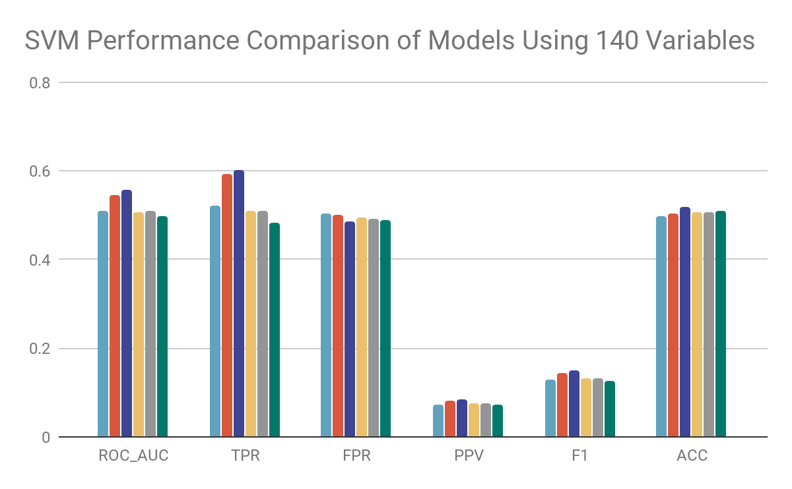
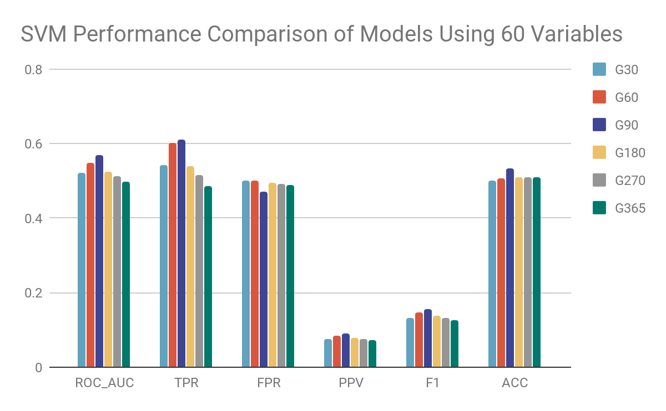
SVM results
!
Removing unimportant features leads to improvement in model accuracy
!
Very small improvements

Slide 20
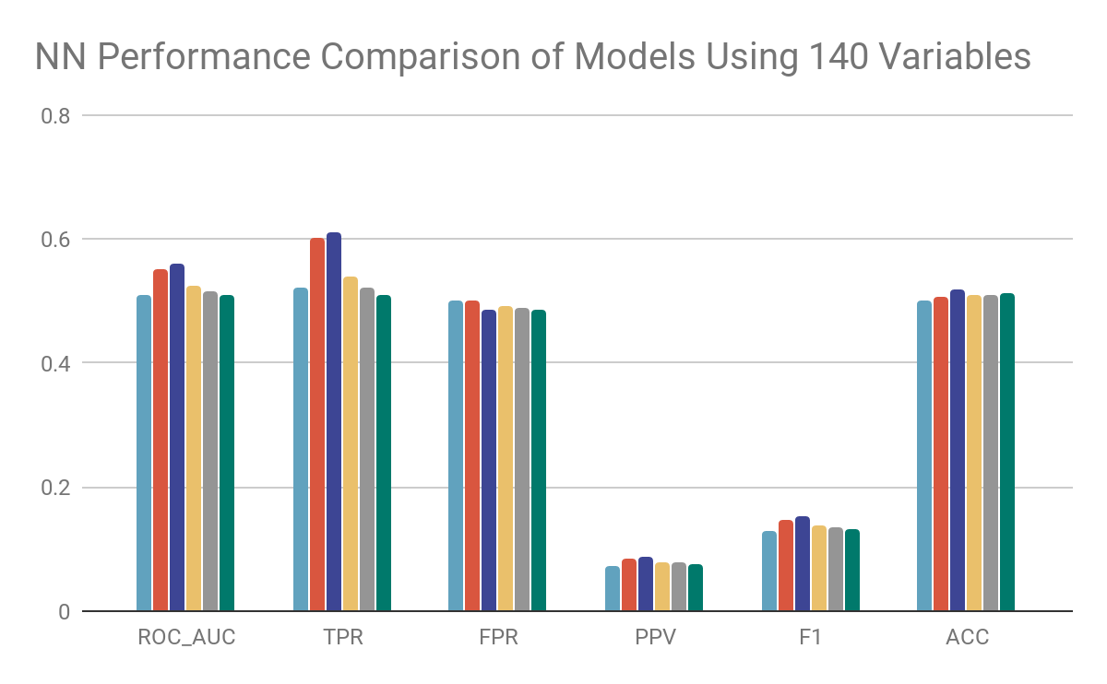
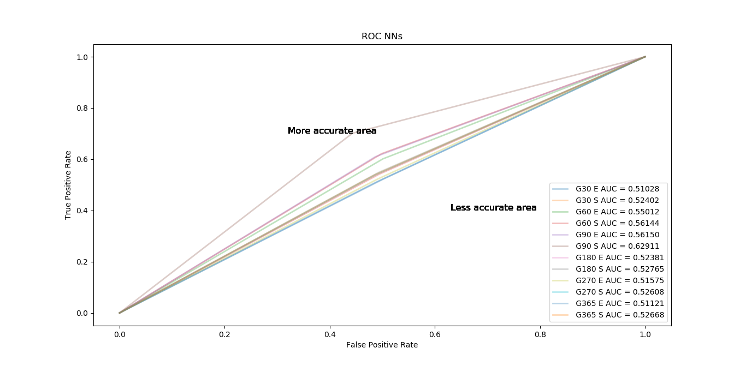
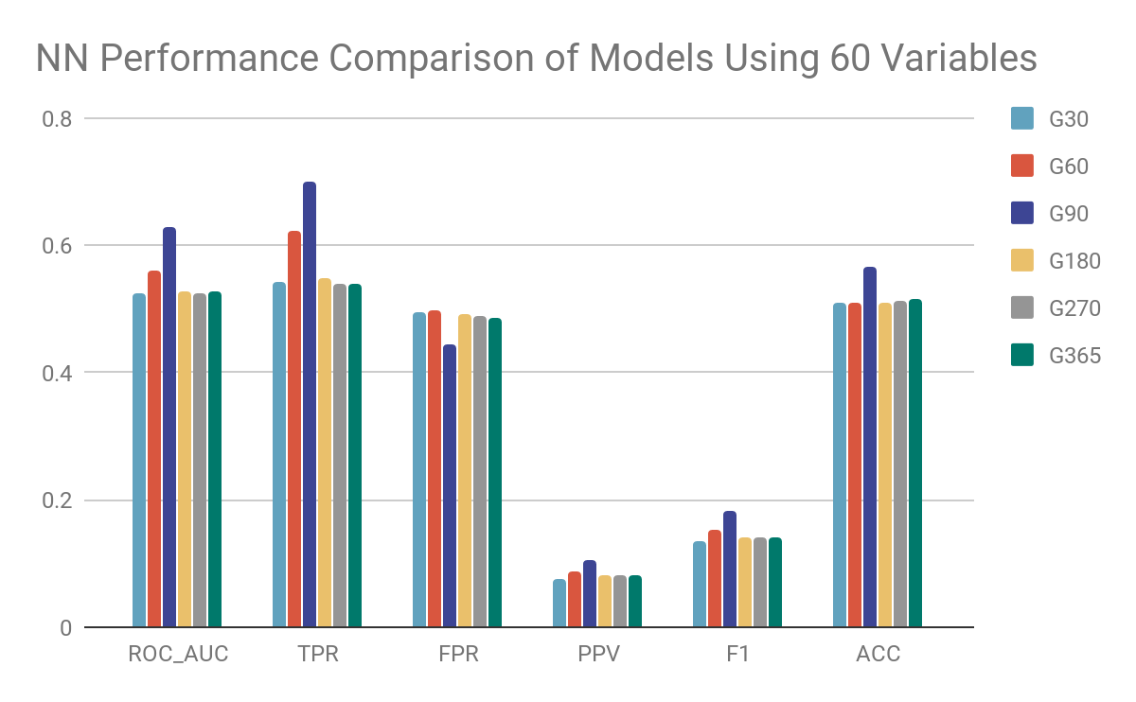
NNs results
!
Removing unimportant features leads to improvement in model accuracy
!
We focus on survival in 90 days (G90)

Slide 21
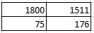
Confusion Matrix in Python
Neural Network
Prediction
0
1
0
TN
FP
TPR=TP/(FN+TP)
FPR=FP/(FP+TN)
PPV=TP/(TP+FP)
F1=2TP/(2TP+FP+FN)
ACC=(TP+TN)/Total
True
1
FN
TP
Small PPV and F1
Model:NN
Target variable: G90
Number of Input features:60
#0 :3311, #1:251
0:Negative, 1:Positive
Notes:
http://scikit-learn.org/stable/modules/generated/sklearn.metrics.confusion_matrix.html

Slide 22
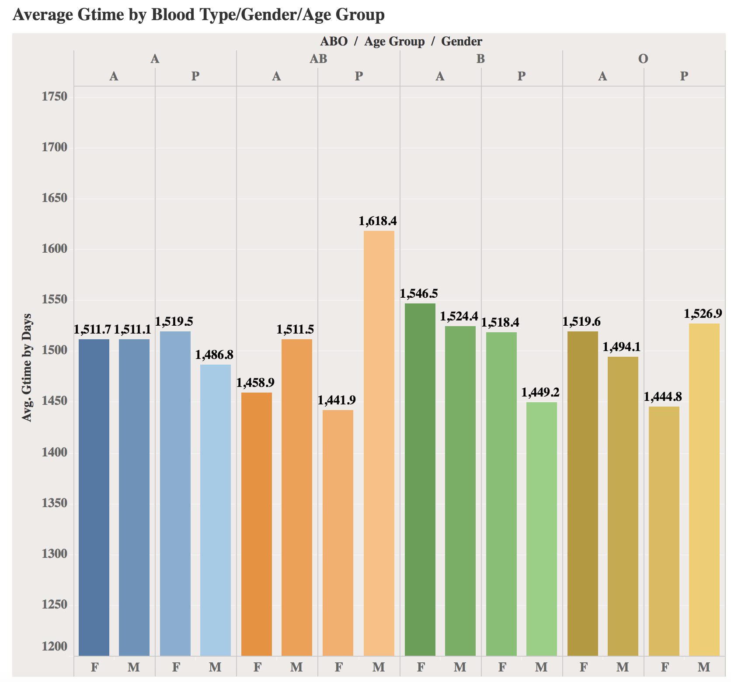
Data Exploration
Insights from Preliminary Analysis
Male pediatric patients of blood type AB have highest average graft survival time
Difference in average graft survival time of female and male seems to be bigger in pediatric patients
No great difference in different blood types except for AB
All of these variables will be considered in multivariate analysis

Slide 23
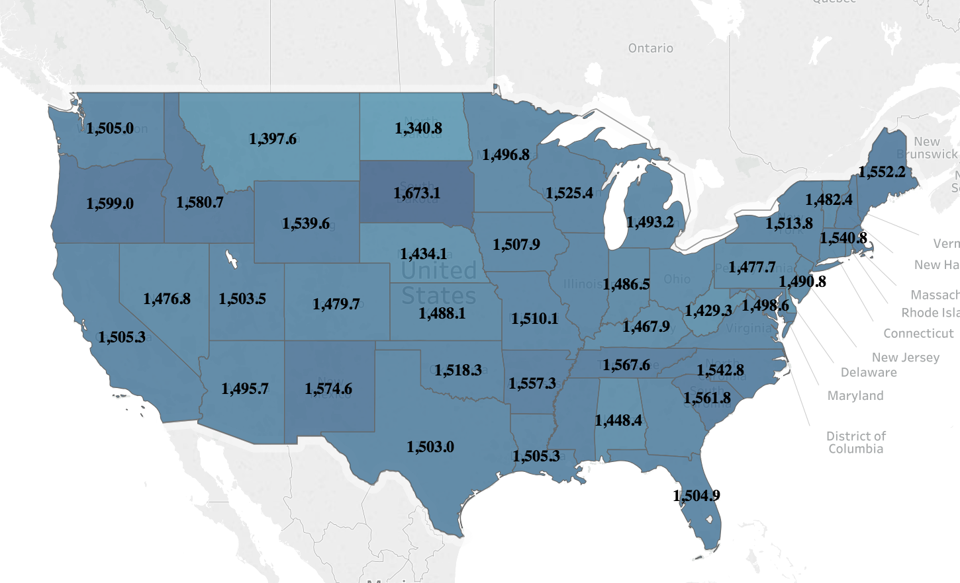
Data Exploration
Average Graft Survival Time by State
Insights from Preliminary Analysis
On average, graft survival across the U.S. ranges from about 800 to 1600 days
Small differences between states
Interested in the effect of living in different states on survival, so the state variable will be added to multivariate analysis

Slide 24
Regression Model
Forward Selection
Subset Selection
Start with 0 variable, add 1 variable at a time
Stop when stopping rule criteria reached (AIC)
Best Subset
Backward Selection
Start with all variables, remove 1 variable at a time
Stop when stopping rule criteria reached (AIC)
Consider all possible combinations of predictors
Long computational time

Slide 25
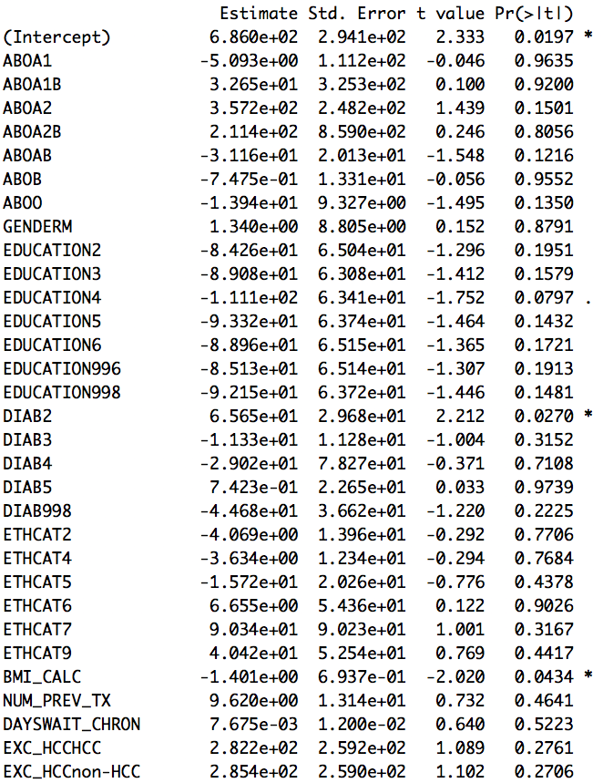
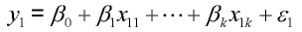
Regression Model
Backward Selection
GTIME
All other features to be considered
Baseline model AIC: 570831.1
Selected model AIC: 569712.5
!
R² very low: 0.0022

Slide 26
Regression Model
Feature Selected
Demographic Variables | Transplantation Related Variables
Blood Type (ABO) | Number of Previous Transplantation
Gender | Days on liver waiting list
Education | Type of Exception Relative to HCC
Diabetes | Region of Transplantation
Ethnicity | State of Registration
BMI | Albumin, Ascites, Bilirubin, Dialysis prior week, Encephalopathy, INR, Serum Creatinine
 | MELD or PELD Score

Slide 27
Regression Model
Backward Selection
Testing whether the coefficient estimate is 0 and obtain the test significance (p-value)
Low p-value : data unlikely come from a true null (coef = 0) →coef is not 0 and the covariate has significant effect

Slide 28
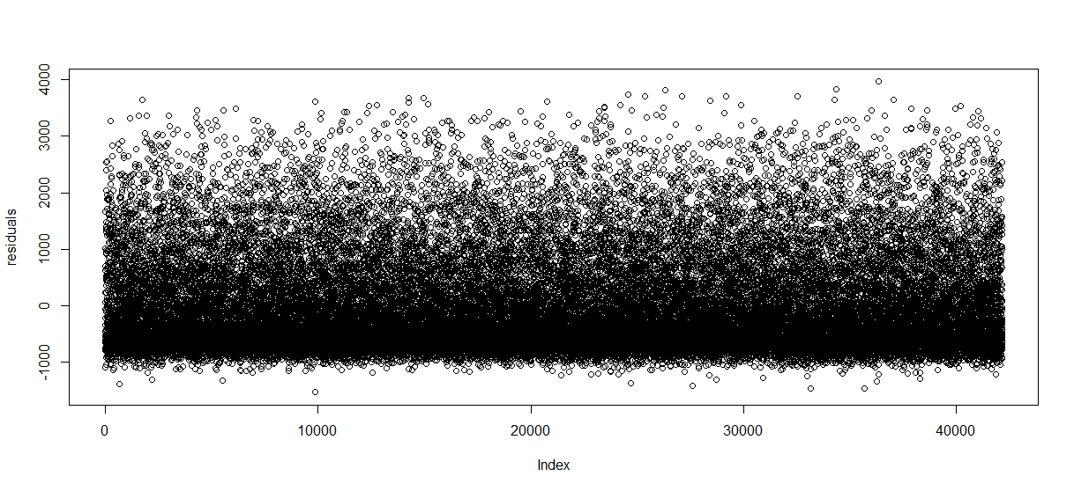
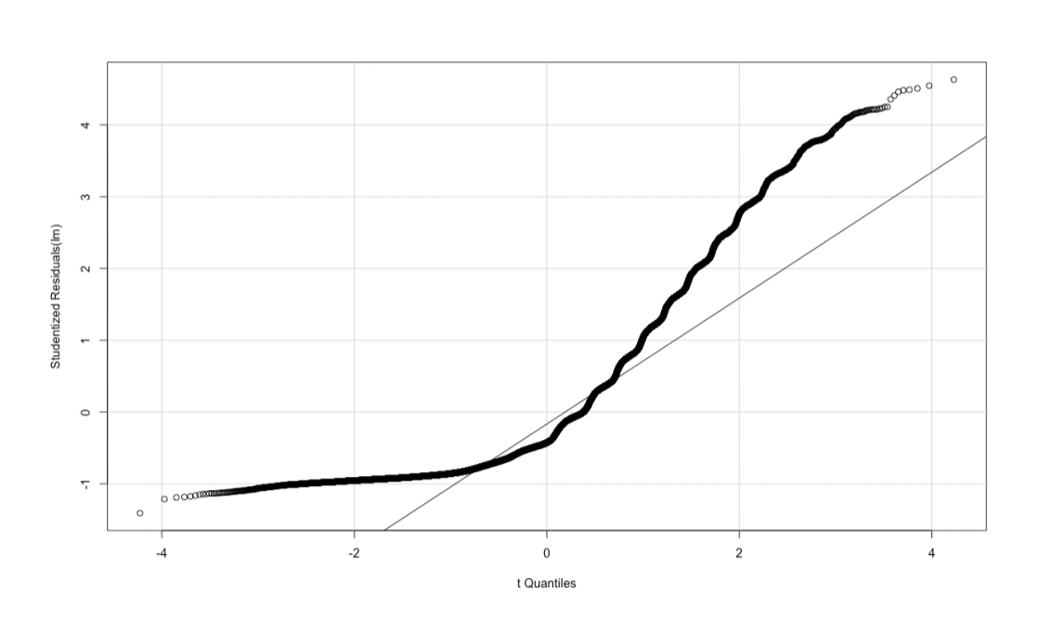
Regression Model
Check Assumptions
Residual Plot
Homoscedasticity (Equal Variance)
QQ-Plot
Normality
!
Assumption Violated
!
Assumption Violated
Notes:
Assumptions: Residuals are normally distributed
Residual plots should show distribution similarly on top and below the horizontal 0 line and across all x values

Slide 29
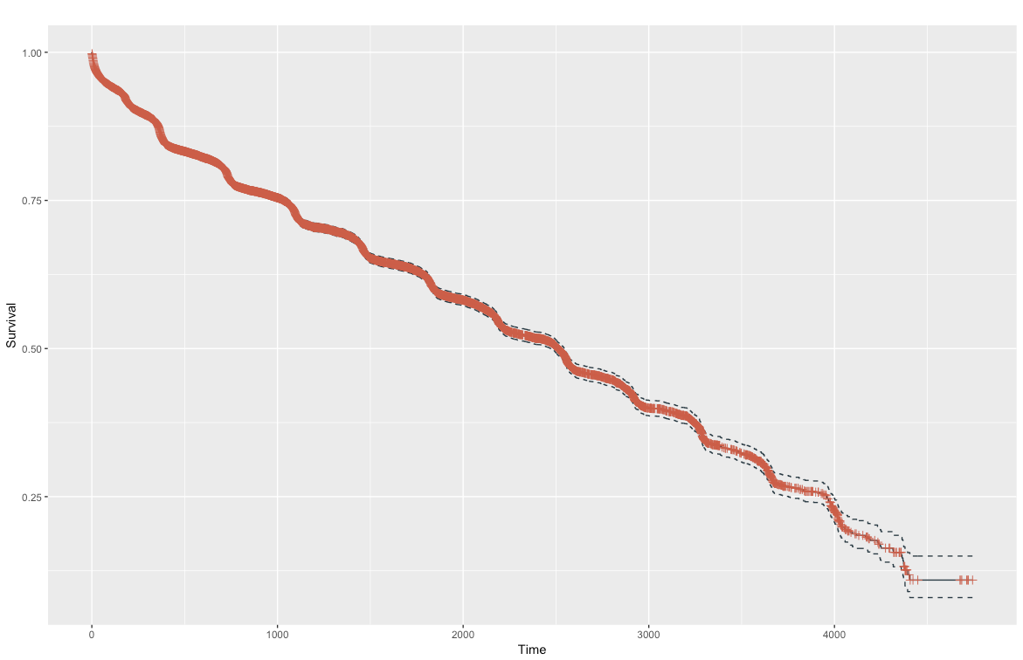
Survival Analysis
Cox Regression-Overview
t =survival time
h(t|x) =hazard function (probability that if a person survives to t, they will experience the event in the next instant)
the coefficients {β₁,β₂,...,β_{k-1}} measure the impact of covariates
the term h₀ is called the baseline hazard. It corresponds to the value of the hazard if all the x’s are zero (exp(0) =1)
Notes:
http://www.sthda.com/english/wiki/cox-proportional-hazards-model

Slide 30
Survival Analysis
Fit univariate cox regression
Cox Regression-Steps
Plot residuals to check assumptions
(seem to meet assumptions)
Concordance= 0.583
(analogous to AUC-ROC)
Likelihood Ratio Test:
p=0, statistically significant
(reject the null that the beta coefficients are all zero)
Keep variables that are significant at <0.05
Fit multivariate cox regression, remove variables with too many categories that create errors
Check assumptions and overall performance: test significance and C-index

Slide 31
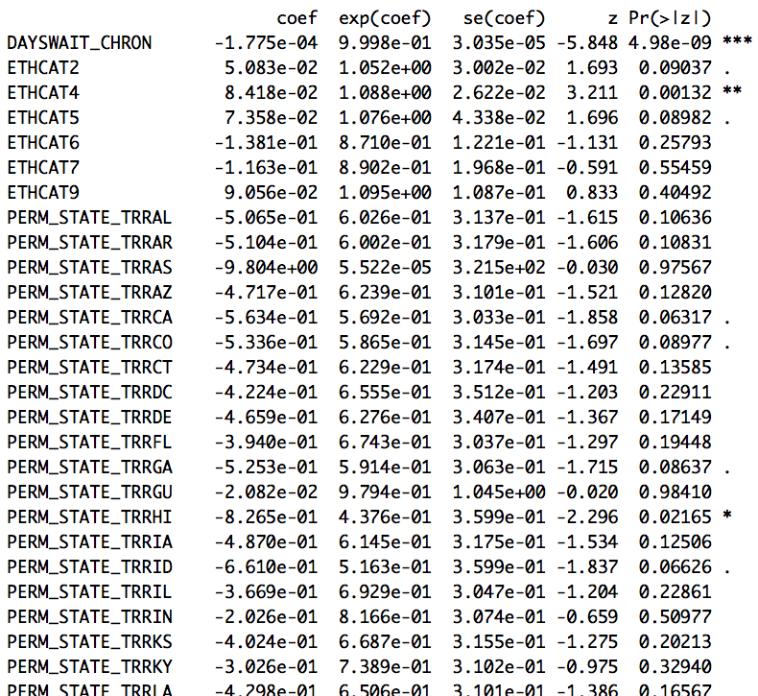
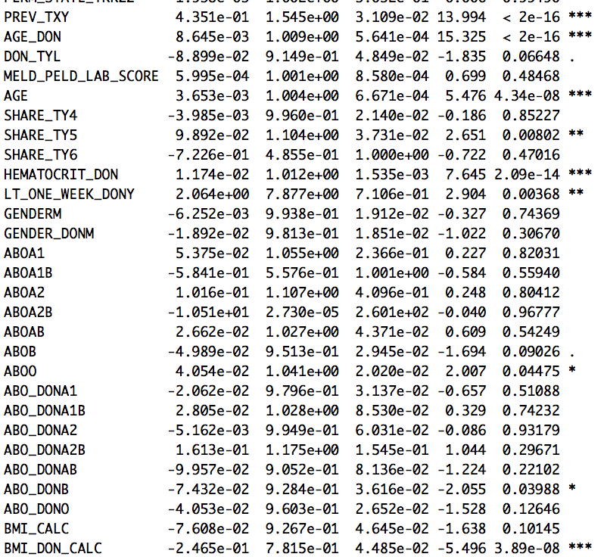
Survival Analysis
Cox Regression-Variables Used
Recipient | Donor
Recipient Age | Donor Age
Recipient Gender | Recipient Gender
Recipient Blood Type | Recipient Blood Type
Recipient BMI | Recipient BMI
Recipient MELD/PELD Score | Donor Type
Previous Transplant | Donor Hematocrit
State of Residency Where Transplant will Take Place | Donor Less Than 7 Days Old at Time of Donation
Days on Waiting List
Recipient Ethnicity
Allocation Type

Slide 32
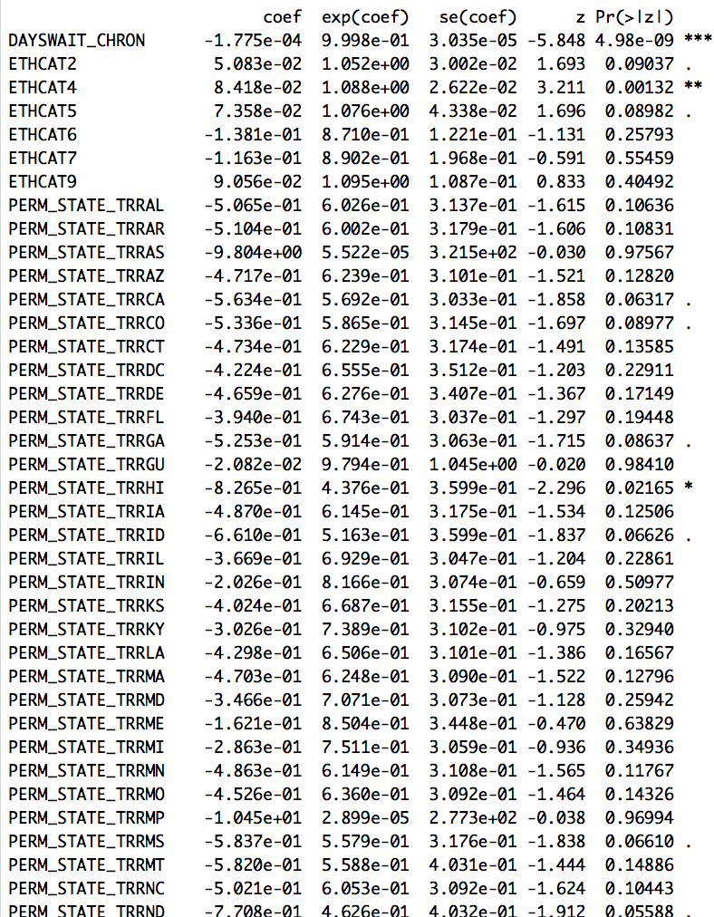
Survival Analysis
Cox Regression-Variable Significance
Testing whether the coefficient estimate is 0 and obtain the test significance (p-value)
Low p-value : data unlikely come from a true null (coef = 0) →coef is not 0 and the covariate has significant effect

Slide 33
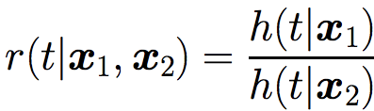
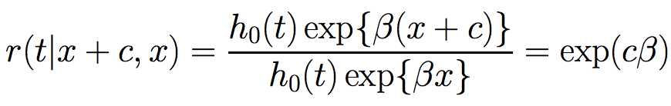
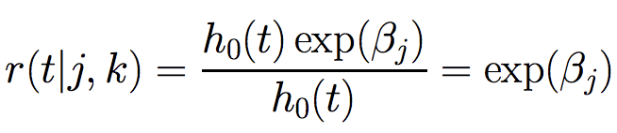
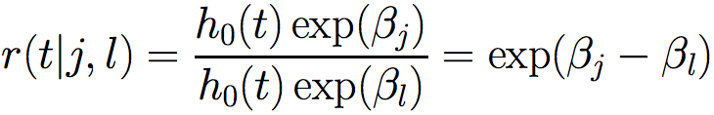
Survival Analysis
Estimate
Cox Regression-Interpretation
Hazard Ratio
Continuous Variable
exp(β)=HR
HR=1: no effect
HR<1: reduction
HR>1: increase
Categorical Variable
Hazard ratio of category j with respect to baseline category k
Hazard ratio of category j with respect to category l
Notes:
https://www.stat.nus.edu.sg/~stachenz/ST3242Notes4.pdf

Slide 34
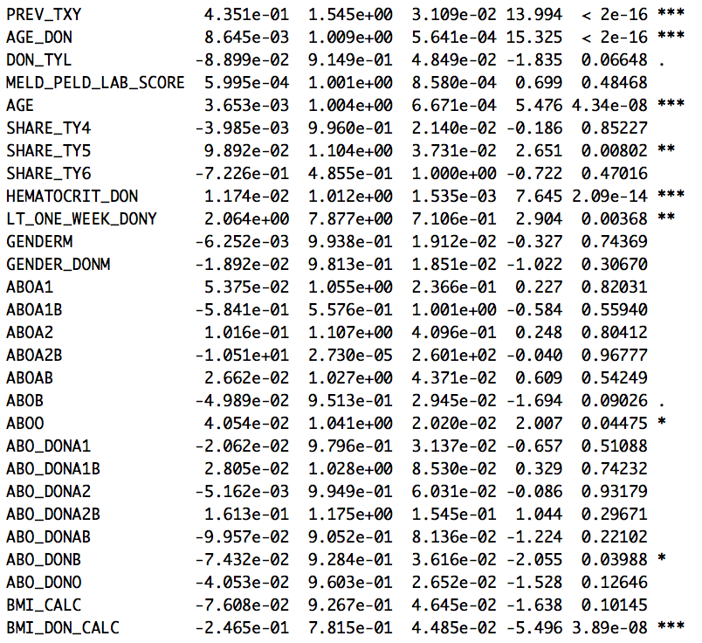
Survival Analysis
Cox Regression-Interpretation
Continuous Variable
Recipient Age
c=1 1-year increase in age of the recipient will lead to 1.004 times more likely to experience graft failure when all other features are the same
c=18 18-year increase in age of recipient will lead to exp(18*0.003653)=1.07 times chances to experience graft failure when all other features are the same

Slide 35
Survival Analysis
Cox Regression-Interpretation
Categorical Variable
Blood group of recipient A A1 A1B A2 A2B
Baseline category is A
Recipient of blood group A1 is 1.06 times more likely than recipient of blood group A to experience graft failure while all features are the same
Recipient of blood group A1B is exp(-0.58-0.054)=0.53 times more likely than recipient of blood group A1 to experience graft failure while all other features are the same

Slide 36
3. Product Demo

Slide 37
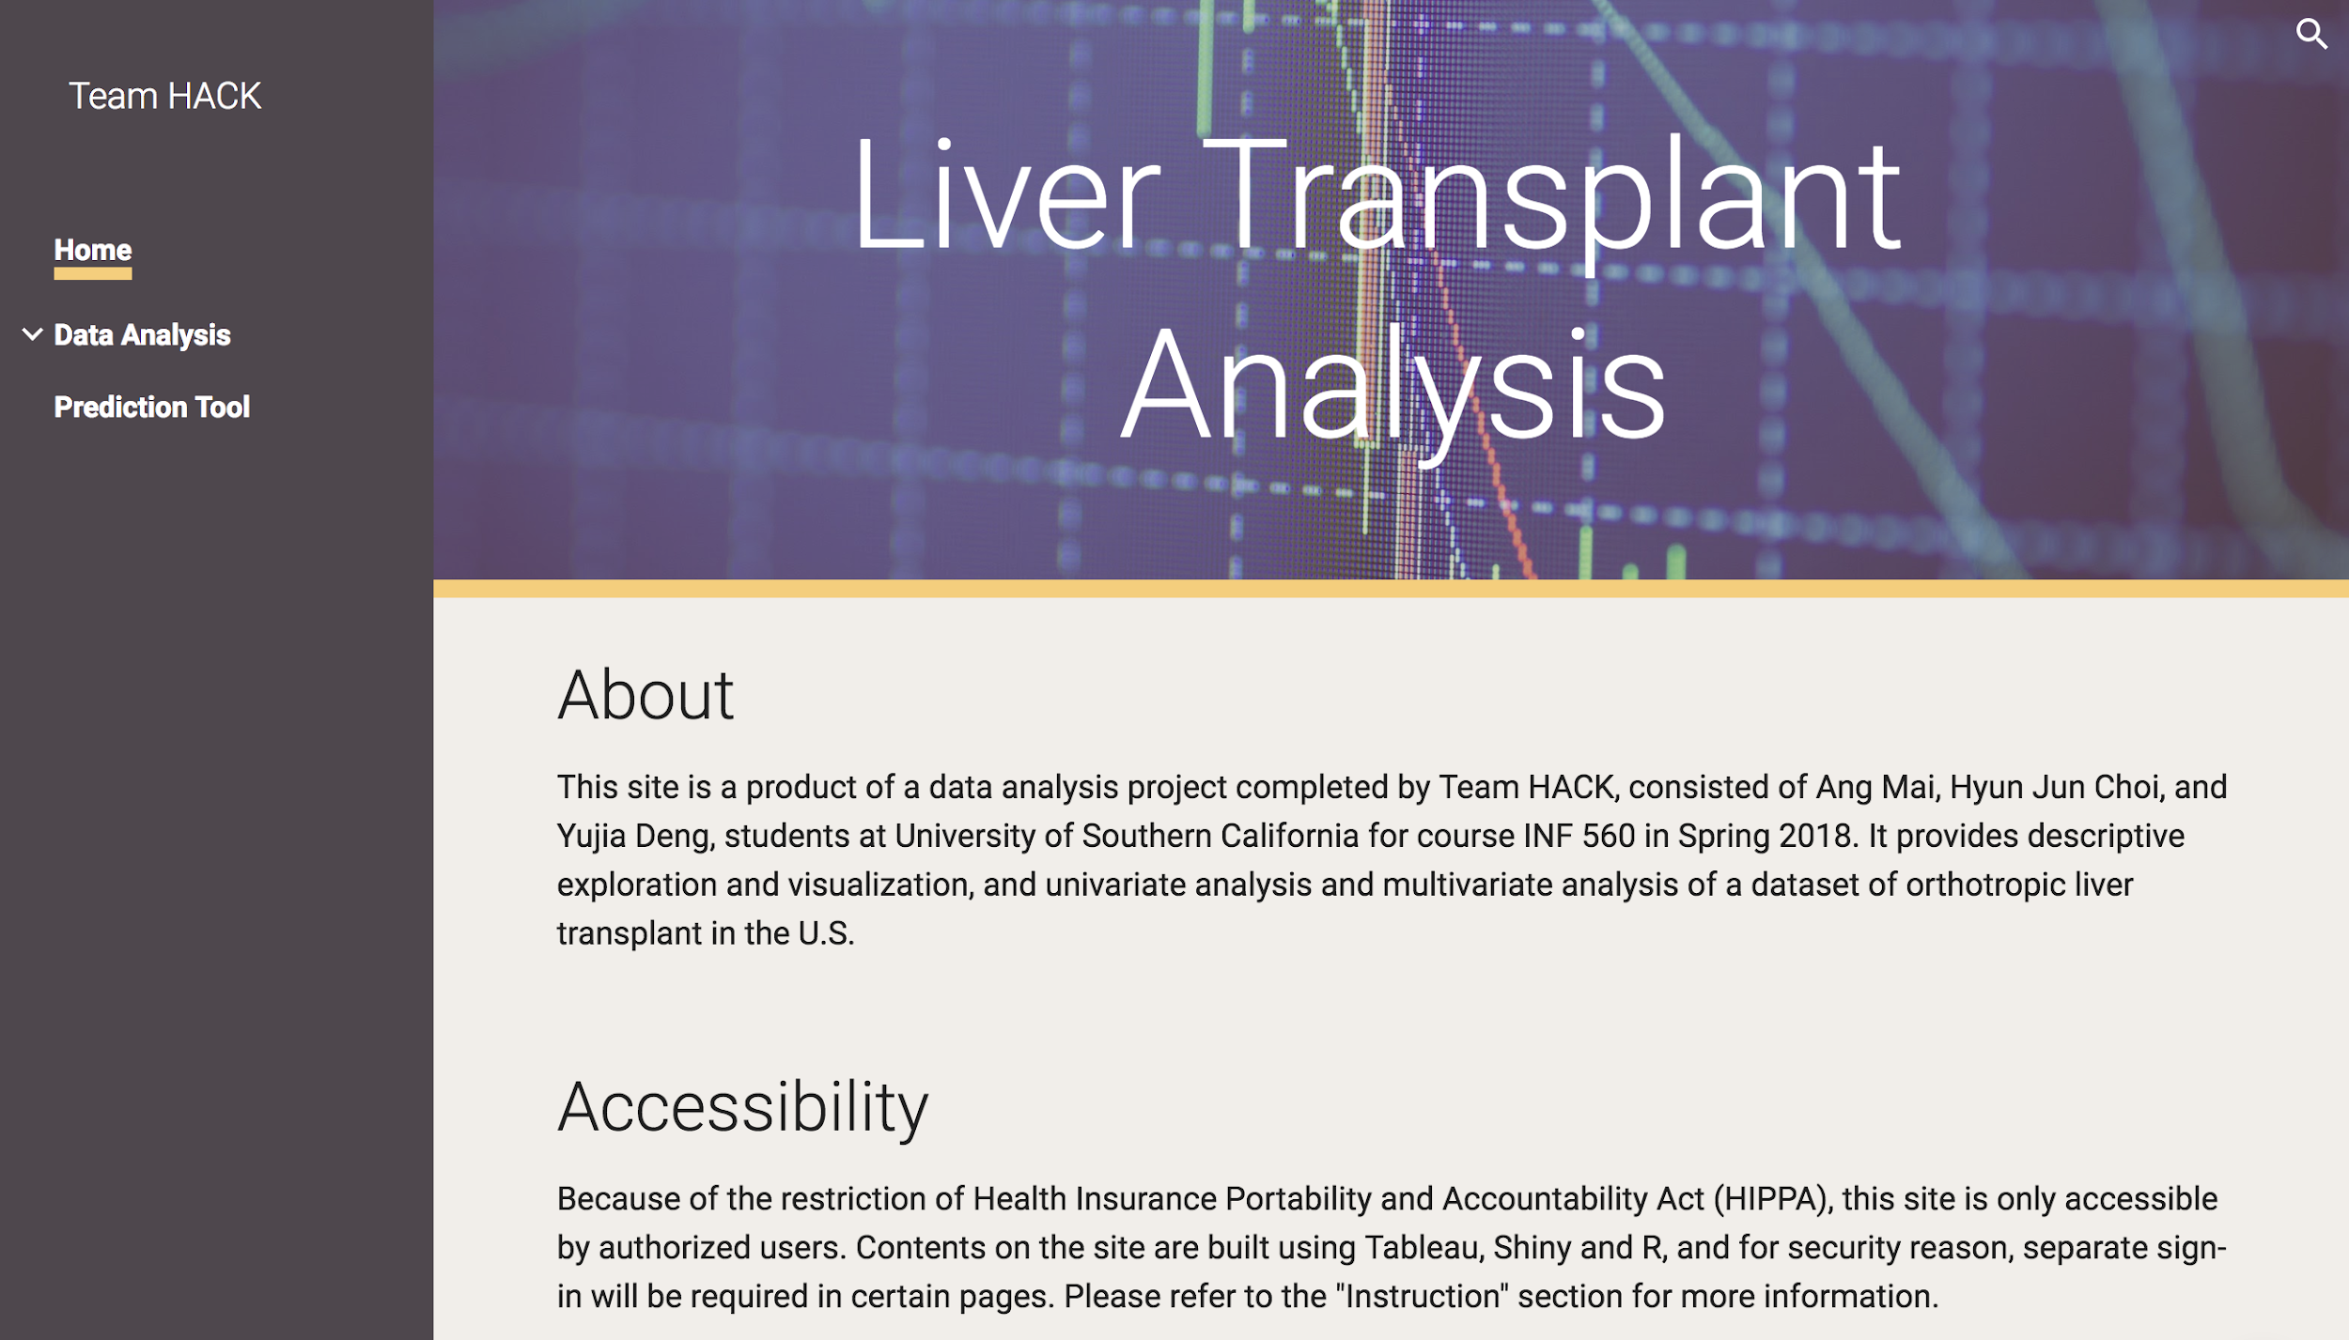
Product Demo
Data Exploration and Prediction
The Cox Regression model is selected to build the prediction tool
It provides more information
It can assess significance and magnitude of effects of covariates have on survival
It can assess difference by factors of categorical variables
Use one model to avoid inconsistencies and confusing results to users

Slide 38




Product Demo
Usage
Use prediction tool to aid in decision making
Patient gets matched with a donor
Patient signs up on waiting list
Patient consults with doctor for information

Slide 39



Product Demo
Usage
Use data exploration and prediction tool to get insights for future research
Students, doctors, biostatisticians

Slide 40
4. Project Closeout

Slide 41
Control and Improvement
Need to follow Gantt Chart more correctly to avoid large amount of work at the end stage of the project
Need to prepare more at the preliminary stage to avoid idea changes (can be good, but it takes time to redo all the work)
Control
Team meeting every week to ensure progress
Live time communication if issues were found
Meeting with TA every week to address questions
Improve-ment

Slide 42



Learning Experience
Data Handling
Preprocess data
Implement and use machine learning algorithm in python
Tune neural network model and SVM
...
Project Management
Initiate, go through and close a project
Good planning is necessary to achieve project goal
Result Delivery
Transfer results into a product that can be used by different users
Build the bridge between numbers, information, and stakeholders
Teamwork
Communication and teamwork are necessary to keep the project flow well
Still a lot to learn and need more experiences

Slide 43

Future Works
Think about different ways to deal with unbalanced data problem in classification
(we used random oversampling in here..)
-Try various Kernel Functions in SVM (B-Spline Kernel, Bessel Kernel, Cauchy Kernel, Chi-Square Kernel, etc)
-Find good neural network structures
Consider using time-dependent cox regression and add more features
Notes:
http://crsouza.com/2010/03/17/kernel-functions-for-machine-learning-applications/

Slide 44
Open Questions
What is the best kernel function with this dataset ?
What is the best way to find good Neural network architecture theoretically and practically?
How can we deal with confounders and effect modification with many features?
?

Slide 45
Reference
Epoch vs iteration when training neural networks. (n.d.). Retrieved from https://stackoverflow.com/questions/4752626/epoch-vs-iteration-when-training-neural-networks?utm_medium=organic&utm_source=google_rich_qa&utm_campaign=google_rich_qa
Kernel method. (2018, April 27). Retrieved from https://en.wikipedia.org/wiki/Kernel_method
Kim, W. R., Smith, J. M., Skeans, M. A., Schladt, D. P., Schnitzler, M. A., Edwards, E. B., . . . Kasiske, B. L. (2014, 01). OPTN/SRTR 2012 Annual Data Report: Liver. American Journal of Transplantation, 14(S1), 69-96. doi:10.1111/ajt.12581
Masconi, K. L., Matsha, T. E., Echouffo-Tcheugui, J. B., Erasmus, R. T., & Kengne, A. P. (2015, 03). Reporting and handling of missing data in predictive research for prevalent undiagnosed type 2 diabetes mellitus: A systematic review. EPMA Journal, 6(1). doi:10.1186/s13167-015-0028-0
Measurement System Analysis (MSA). (n.d.). Retrieved from https://www.moresteam.com/toolbox/measurement-system-analysis.cfm
Organ Procurement and Transplantation Network. (n.d.). Retrieved from https://optn.transplant.hrsa.gov/members/regions/
Patel, S. (2017, May 03). Chapter 2 : SVM (Support Vector Machine) - Theory – Machine Learning 101 – Medium. Retrieved from https://medium.com/machine-learning-101/chapter-2-svm-support-vector-machine-theory-f0812effc72
RBF SVM parameters. (n.d.). Retrieved from http://scikit-learn.org/stable/auto_examples/svm/plot_rbf_parameters.html
Schrem, H., Platsakis, A., Kaltenborn, A., Koch, A., Metz, C., Barthold, M., . . . Reichert, B. (2014, 09). Value and limitations of the BAR-score for donor allocation in liver transplantation. Langenbeck's Archives of Surgery, 399(8), 1011-1019. doi:10.1007/s00423-014-1247-x

Slide 46
thank you for listening
Questions?
Team HACK

